Slide 1
Data Model and Entity
Modified by
Shadman Rabby
Lecturer, Dept. of CSE, Daffodil Internatioal University
Created by
Professor Dr. K. M. Azharul Hasan
Dept. of CSE, KUET

Slide 2
Database Design: Data Model
Data model refers to
modeling of various relations of data in the real world for handling them in computers.
Data models are classified from the viewpoint of modeling.

Slide 3
Database Design: Data Model
Conceptual data model
It models relations of data without considering any specific database.
It defines what kind of data is handled.
Logical data model (external model)
It logically models the relations of data considering a specific database.
It defines interrelations of data in the database.
Physical data model (internal model)
It physically models the relations of data considering a specific database product.
It defines the physical internal structure of a database such as data type.

Slide 4
Database Design: Data Model
Conceptual data model
This model is used to define what kinds of data are handled without worrying about how it is stored or implemented. It represents the overall structure of the data, including entities, attributes, and relationships, but it does not specify technical details such as database tables or keys.
Example:
Suppose you are designing a database for a university. A conceptual data model would define entities like Student, Course, and Professor, along with their relationships (e.g., "Students enroll in Courses" or "Professors teach Courses"). However, it would not specify how these entities are stored in the database.

Slide 5
Database Design: Data Model
Logical Data Model
This model further refines the conceptual model by considering a specific database system. It includes the logical structure of the data, such as tables, columns, and relationships. It defines how the data will be organized within the database, but still without worrying about the physical storage details.
Example:In the same university database, the Student entity might be represented by a table called Students with columns like StudentID, Name, and DateOfBirth. The relationships between entities would be represented by foreign keys and indexes. This model is still independent of physical storage details like data types or indexing methods.

Slide 6
Database Design: Data Model
Physical Data Model
This model defines the physical structure of the database. It considers the specific database product being used and includes details like data types, indexes, and partitioning strategies. The physical model is concerned with how the data is actually stored in the system.
Example: Continuing with the university database example, the Students table might be implemented with specific data types (e.g., StudentID as an INTEGER, Name as a VARCHAR(100)) and indexes for faster querying. The physical data model might also specify the use of a certain file format or storage strategy that is optimal for the database system being used (e.g., MySQL, Oracle).

Slide 7
Database Design: Data Model
Three data models are common
Hierarchical model
It is a data model that represents the relations of data as a hierarchical structure
where parent and child are in a one-to-many relationship.
It is implemented as HDB(Hierarchical DataBase).
Network model
It is a data model that represents the relations of data as a hierarchical structure where parent and child are in a many-to-many relationship.
It is implemented as NDB(Network DataBase).
Relational model
It is a data model that represents the relations of data in a two-dimensional table.
It is implemented as RDB (Relational DataBase).

Slide 8
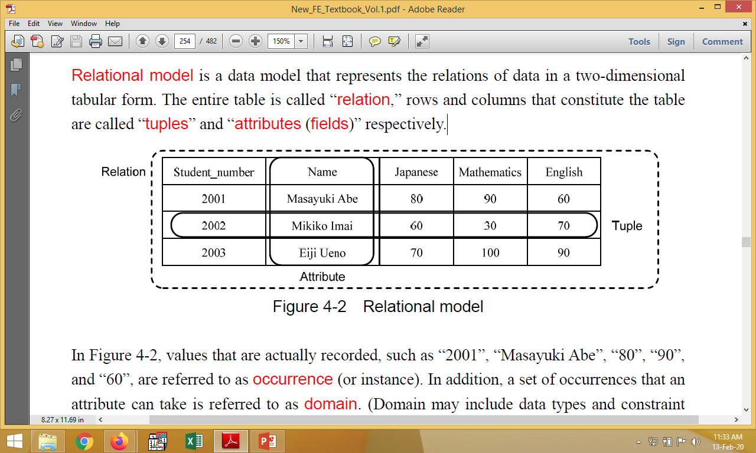
Relational Model
Relational model is a data model that represents the relations of data in a two-dimensional tabular form.
The entire table is called “relation,” rows and columns are called “tuples” and “attributes (fields)” respectively.

Slide 9
Relational Model
Values that are actually recorded, such as “2001”, “Masayuki Abe”, “are referred to as occurrence (or instance).
A set of occurrences that an attribute can take is referred to as domain.
Domain may include data types and constraint conditions of attributes.
Relation is defined as a subset of the direct product of domains.
Direct product: a set operation that obtains all combinations,
Subset: a set that is included in a certain set

Slide 10
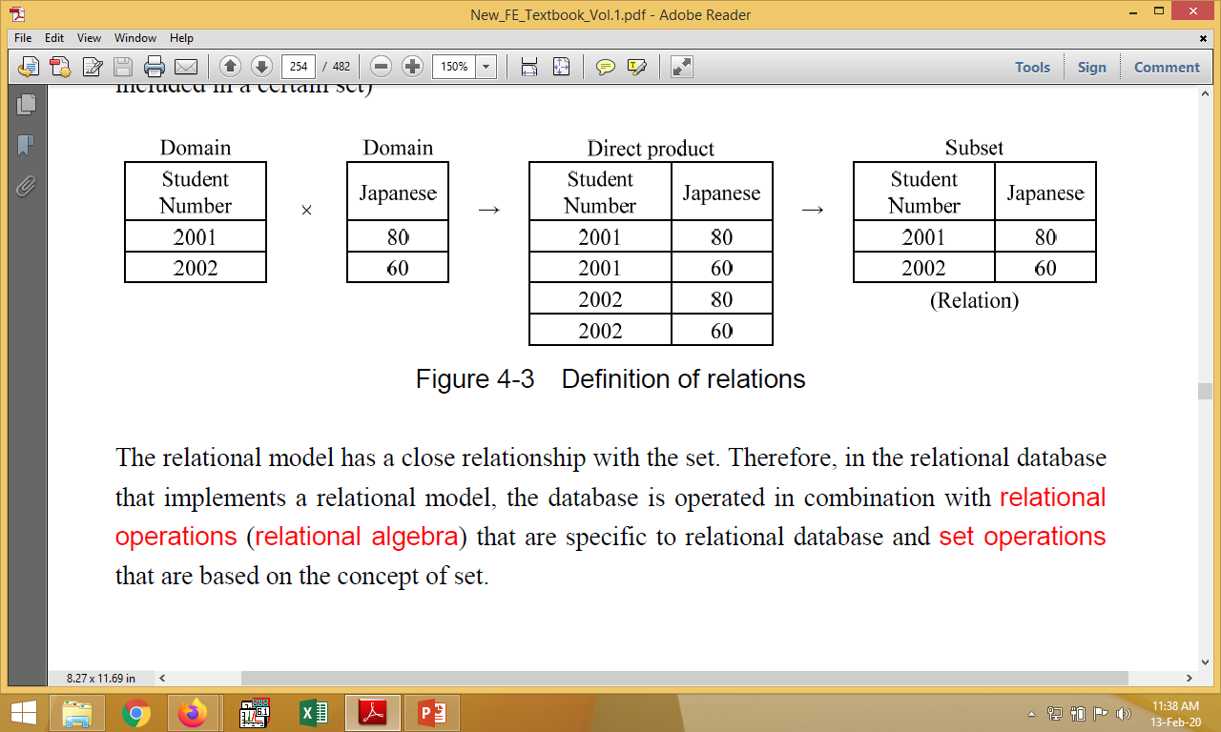
Relational Model
The relational model has a close relationship with the set.
in the relational database that implements a relational model, the database is operated in combination with relational operations (relational algebra) that are specific to relational database and set operations that are based on the concept of set.

Slide 11
Conceptual Design of Databases
Conceptual design of databases is the process of creating conceptual data models.
It is necessary to conduct data analysis at the beginning.
The data analysis identifies the data that is required for the targeted operations
where database is implemented, and then the meaning and relation of this data are analyzed and summarized.
Data items are standardized by using rules such as naming convention in order to eliminate data duplication

Slide 12
Metadata
In the context of Database Management Systems (DBMS), metadata refers to data about data. It describes the structure, organization, and characteristics of the data stored within the database. Essentially, metadata provides information about the data itself, which helps in managing, retrieving, and understanding the actual data. Metadata is often stored in system tables or catalogs within the database.
such as names, meanings, or attributes of data items are recorded in the data dictionary for users in DD/D (Data Dictionary/Directory) to ensure that synonyms/homonyms do not occur.

Slide 13
Constituent elements of E-R model
Entity
It is an object that is managed and represented with a rectangle.
Relationship
It is a relation between entity and entity.
Attribute
It is a characteristic or property of an entity and a relationship, and it is represented with an ellipse

Slide 14
Representing Objects
Objects have a name, e.g. ball, car
Objects have attributes (data) which define their states, e.g. weight, doors, seats
Objects have operations (methods) which define what can be done with them, to them or by them e.g. start, stop, turn, load, unload, throw, bounce

Slide 15
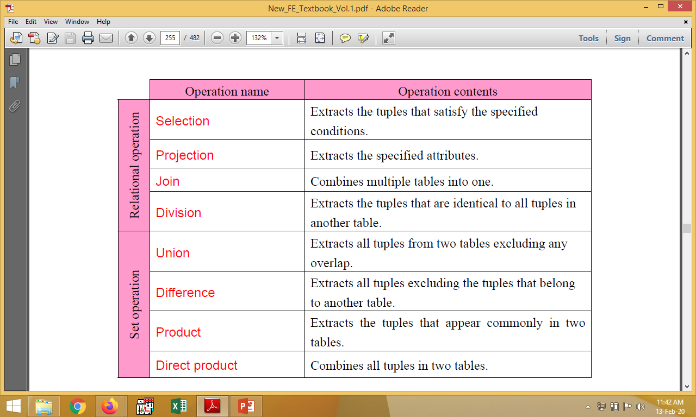
Relational Operations

Slide 16
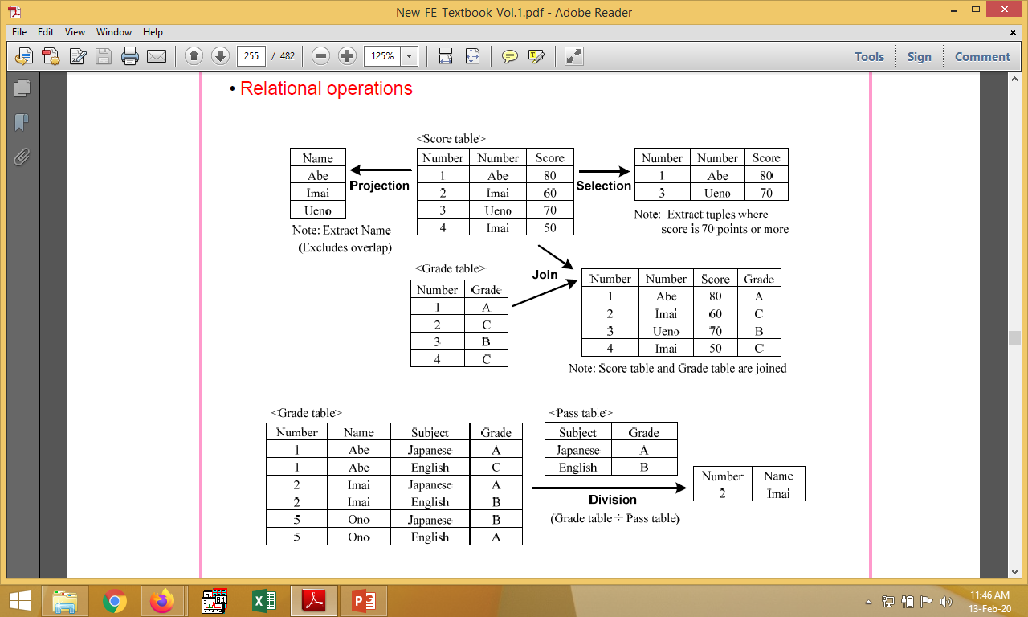
Relational Operations
Name
Name
Name

Slide 17
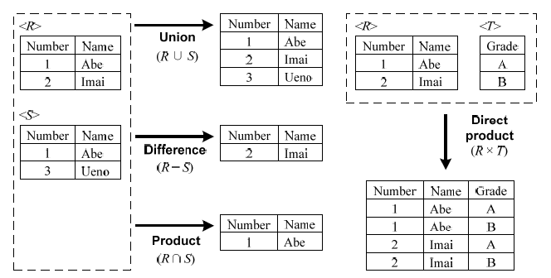
Set Operations

Slide 18
Manipulations of the relational database
Insert: Adding new data (i.e., tuples) in a relation (i.e., table)
Update: Changing (i.e., updating) the data (i.e., tuples) recorded in a relation (i.e., table)
Delete: Deleting the data (i.e., tuples) recorded in a relation (i.e., table)

Slide 19
Thank you

